Slide 1
SESAMI SST Fiber Cable Path & Room Layouts

Slide 2
Bldg. 447 East Side Fiber Path
Run 36-strand single-mode fiber cable from Bldg. 447 Room S123 (IST Comm) through Room 030 (Core Node) to Bldg. 442, Room 510 (OBAC Equipment Room)
  Cable passes through Room 030, does not terminate in Room 030
  Terminate in Bldg. 447, Room S123 to IST Cab 1, Patch Panel 2 (new patch panel needed at U40 of rack) using LC connections
  Terminate other end of cable at Bldg. 442, Room 510 to Rack 01B, U1 using LC connections
Run 16-strand single-mode fiber cable from Bldg. 447, Room S123, to Bldg. 447, Room S122 (SST Server)
  Terminate in Room S123 to IST Cab 1, Patch Panel 2 using LC connections
  Terminate in Room S122 to SST Cab 8 using LC connections

Slide 3
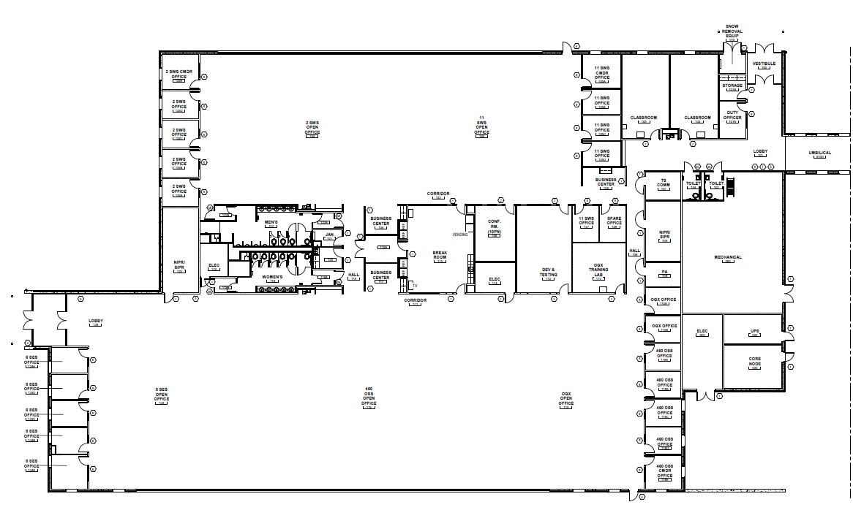
Bldg. 447 West Side Fiber Path
Run 36-strand single-mode fiber cable from Bldg. 447 Room S123 (IST Comm) through Room 030 (Core Node) to Bldg. 442, Room 510 (OBAC Equipment Room)
  Cable passes through Room 030, does not terminate in Room 030
  Runs through Protected Distribution System (PDS) conduit

Slide 4
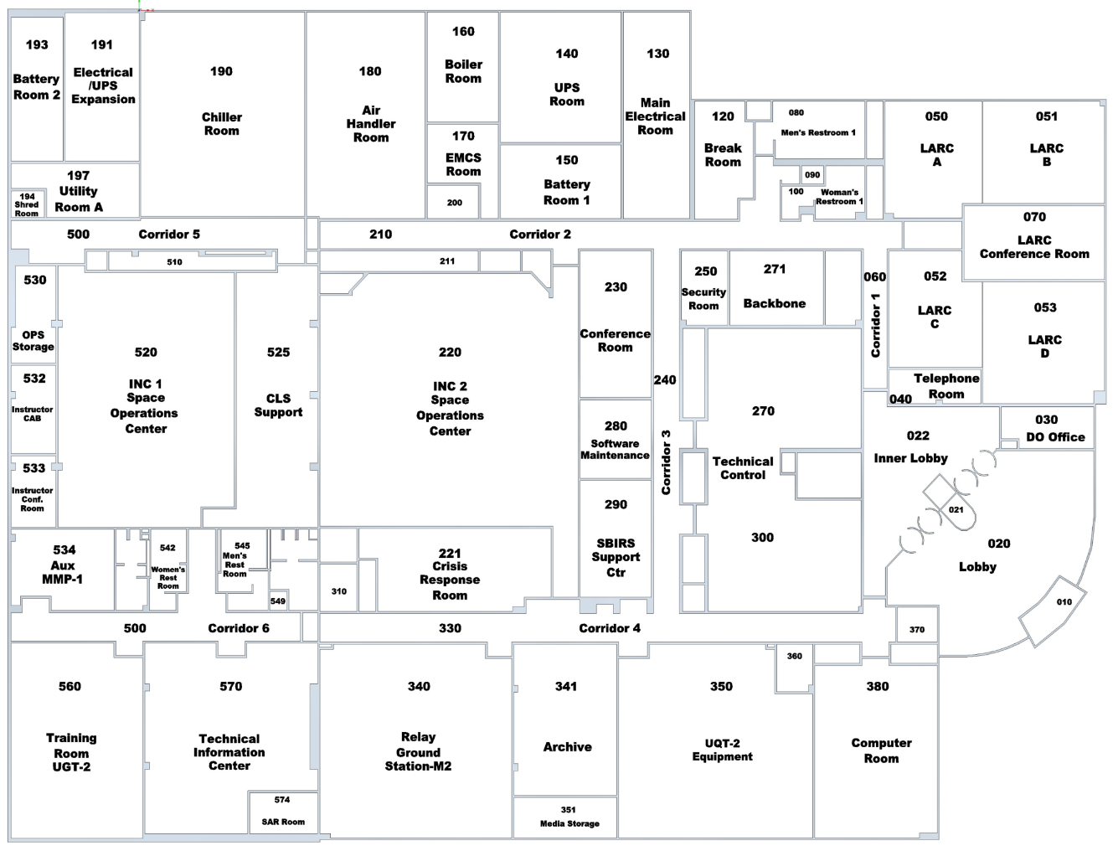

Bldg. 442
SESAMI SST Fiber Path
36-strand (18-pair) single-mode fiber cable ran from Bldg. 447, Room S123 (IST Comm) direct to Bldg. 442, Room 510
  Annotated by red lines
  Runs through PDS conduit from facility exterior to Room 271
  Opens into cable trays in Room 271
2-strand (1-pair) single-mode fiber cable ran from Bldg. 442, Room 510 (Rack 1B) direct to Bldg. 442, Room 300 (Rack 5164)
  Annotated by blue lines
Rack 5164
From Bldg. 447

Slide 5
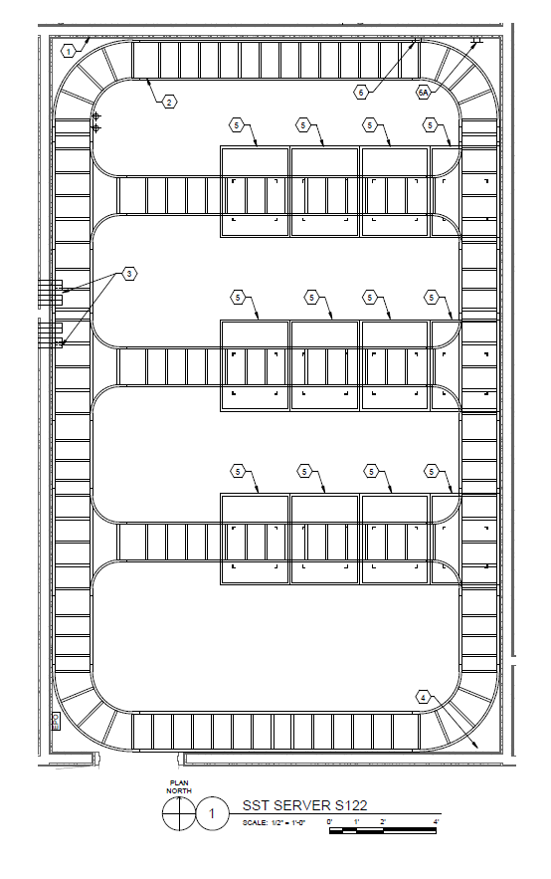
Bldg. 447 Room S122
16-strand fiber cable termination point (Rack 8)
PDS Conduit from Room S123 entry point into Room S122

Slide 6
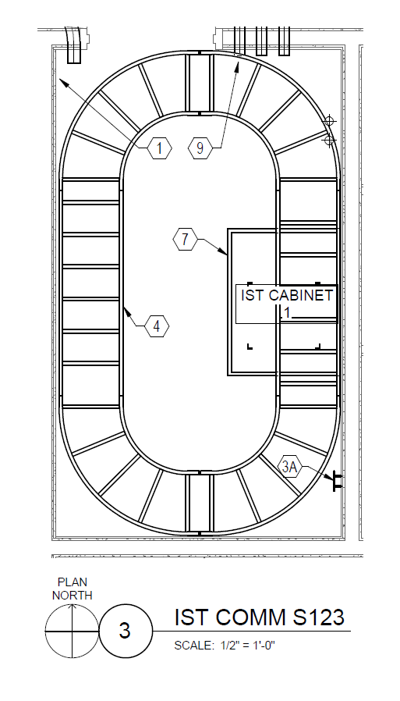
Bldg. 447 Room S123
PDS Conduit from Room S122 entry point into Room S123
PDS Conduit from Room 030 entry point into Room S123
16-strand fiber cable termination point (S123 to S122 cable connection)
36-strand fiber cable termination point (S123 to Bldg. 442 Room 510 cable connection)

Slide 7
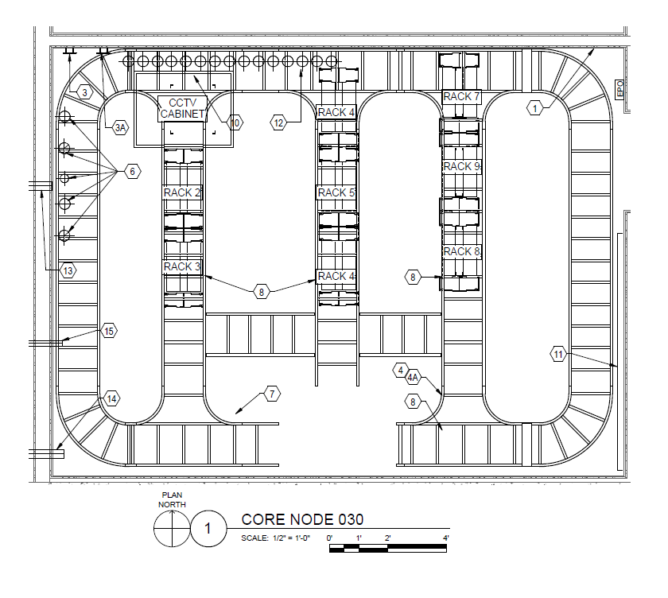
Bldg. 447 Room 030
PDS Conduit from Room S123 junction point into Room 030

Slide 8

Questions?
Videmus Mundum

Slide 9
Backup
Backup

