Slide 1
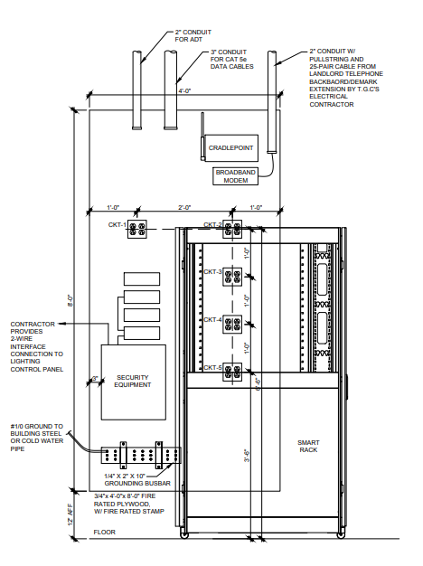
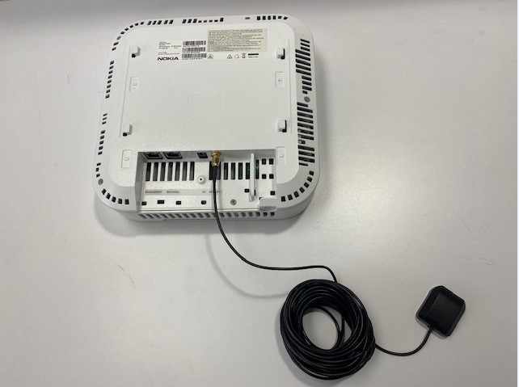
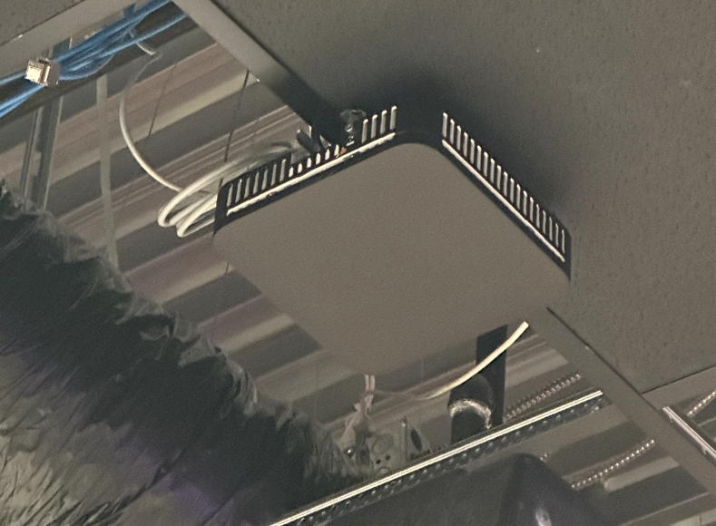
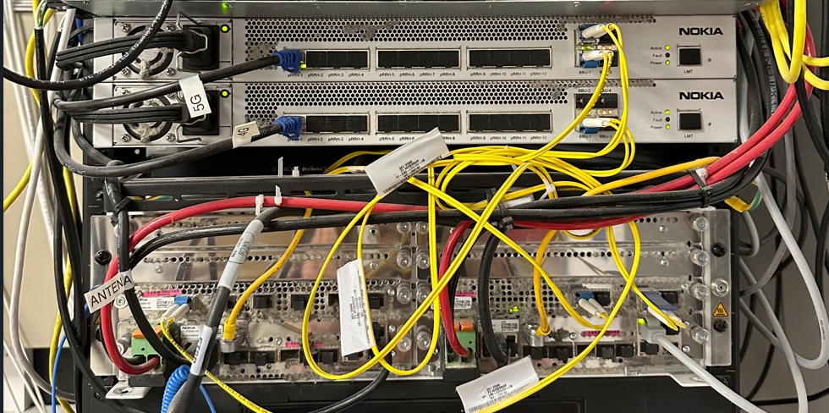
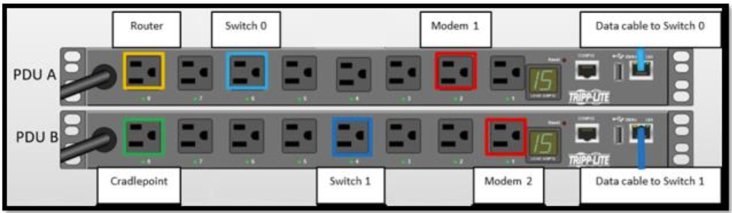
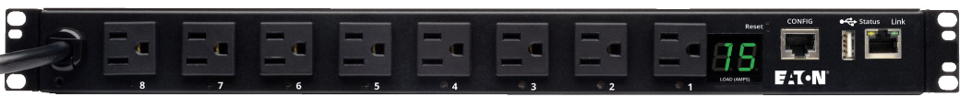
T-Mobile Rack- Power Distribution
3” Conduit for Tyco
Two 4” Conduits for CAT6
5G and Small Cells hardware should have their own dedicated and labeled quad at the backboard that no other equipment should be plugged in to.
This equipment should never be touched or unplugged by Retail Technology or powered off at the breaker by the GC.- Reach out to your PM for any questions.
Vertical PDUs to be used for all non-network hardware (Tyco, Mood Media, etc)
Note: It is acceptable to use a different quad outlet for the various equipment shown on this diagram if it is in closer proximity to the equipment. The important part is that each group of equipment has a dedicated quad and that the power load is evenly distributed.
Horizonal Networked PDUs to be used for Routers/Switches, CradlePoint. (Telco modems too if applicable)

